Slide 1
Mahindra First Choice Services-Customer Segmentation For Marketing Campaign
Done By
Shailendra Jain
Gomathi.T
Juhi Patel

Slide 2
About MFCS
MFCS is a group company of Mahindra.
India’s leading chain of multi-brand car workshops with 335+ workshops present in 267+ towns and 24 states.
List of Services provided by MFCS:
1.Periodic maintenance services 2.Running repairs 3.Body repair 4.Warranty beyond warranty 5.Car care 6.Wheel care
Private label spare parts for all brand cars under the name MFC.
Notes:
Periodic maintenance service is like regular service
Running repairs is required when any component is not working properly or worn out
Body repair includes dent,paint scratches
Wheel care is wheel alignment and damaged wheel
Car care both interior and exterior
Spare parts like air,fuel and oil filter,lubricants & coolants,suspension and steering products,Wiper blade

Slide 3
Data In Hand
5 different csv namely customer,invoice,jtd,plant and vehicle.
Customer csv: 5,55,338 rows and 10 columns.
Invoice csv: 9,84,741 rows and 59 columns.
Jtd csv: 5619484 rows and 10 columns.
Plant csv: 483 rows and 14 columns.
Vehicle csv: 588761 rows and 5 columns.
Notes:
Most of the customer were of retail partner type

Slide 4
Data Cleaning
Checking for missing values.
Dropping columns having missing values greater 70%.
Filling missing values with mode.
Stripping leading zero in customer no column.
Converting columns to string type for merging.

Slide 5
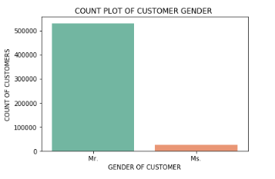
Data Insights
Male Customers come more frequently than female customers
For every 21 male customers coming for the service only 1 female customer comes in fo

Slide 6
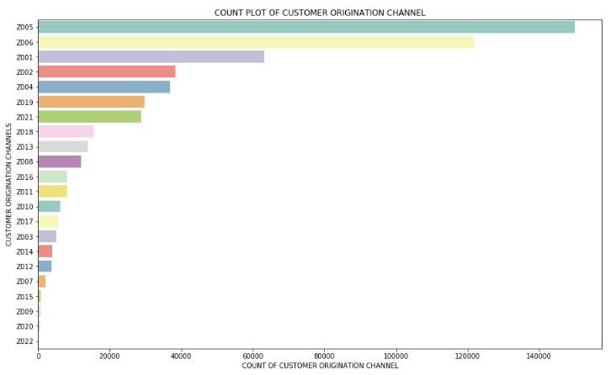
Data Insights
Customer Origination Channel
Z005 i.e Reference from customers tops the list
Z006 i.e Reference from employees
Z001 i.e Outdoor camping

Slide 7
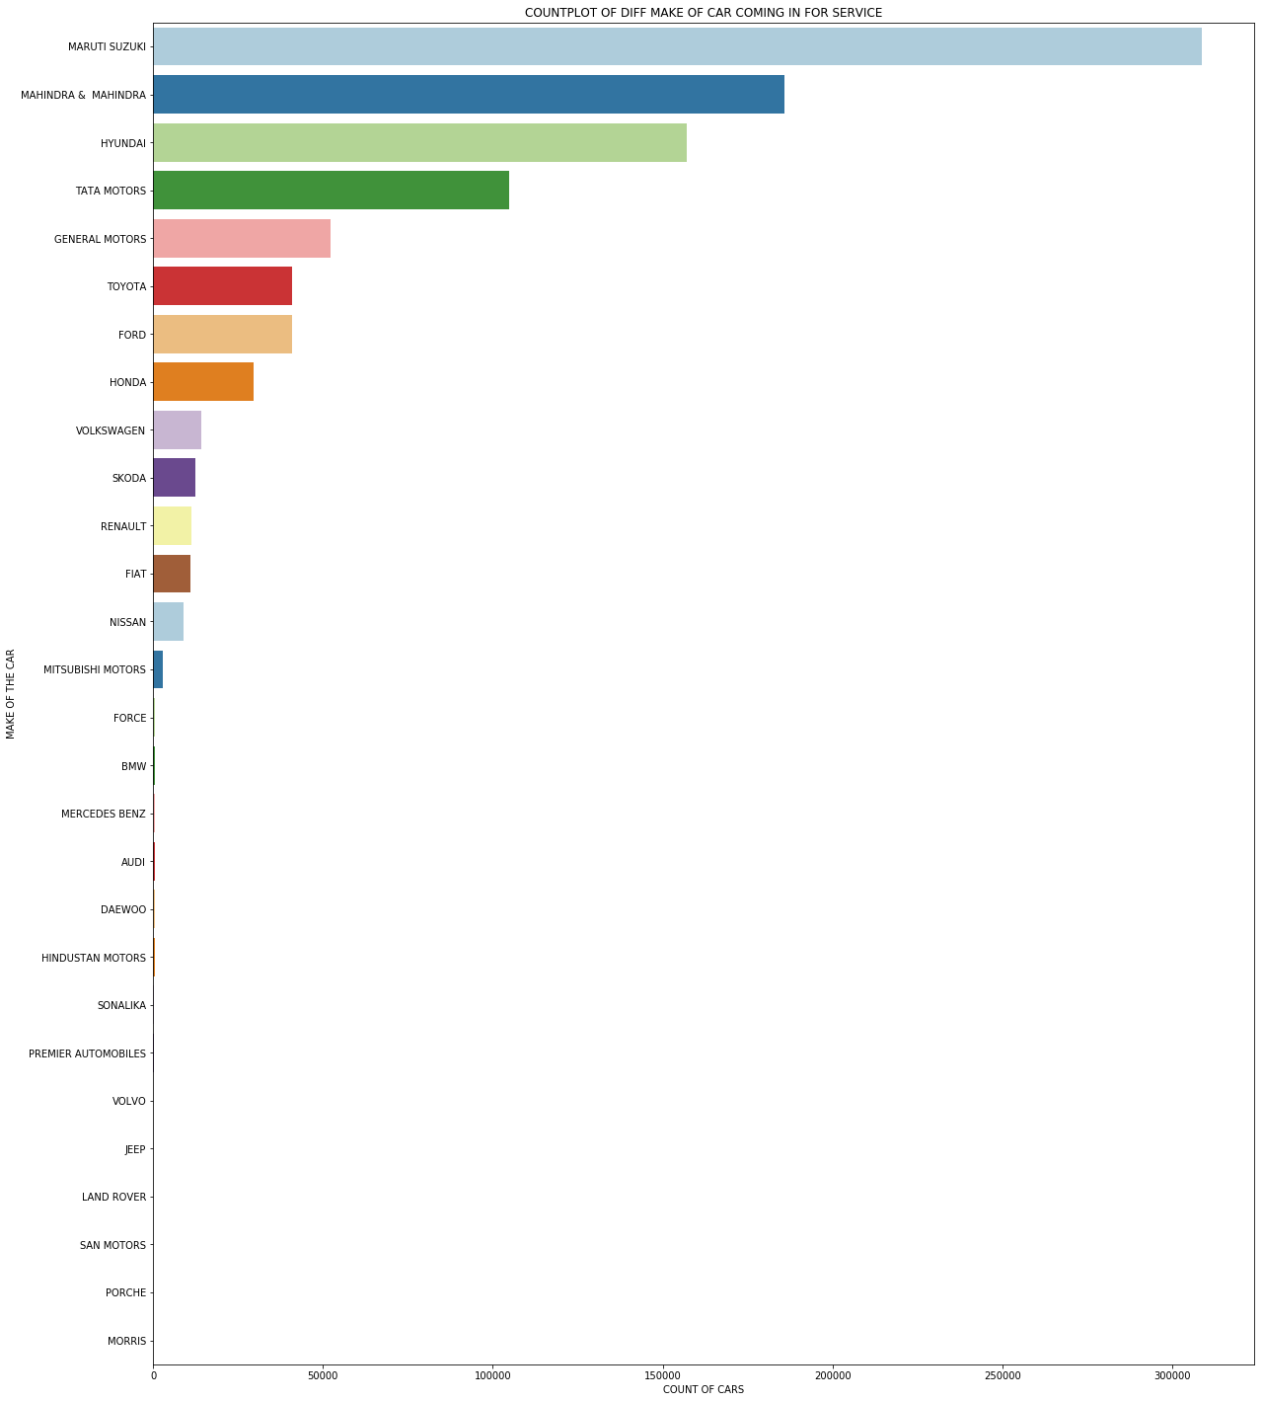
Data Insights
Countplot Of Diff Make Of Cars Coming In For Service Across India
Maruti Suzuki comes more often followed by
Mahindra and Hyundai.
What can the reason?

Slide 8
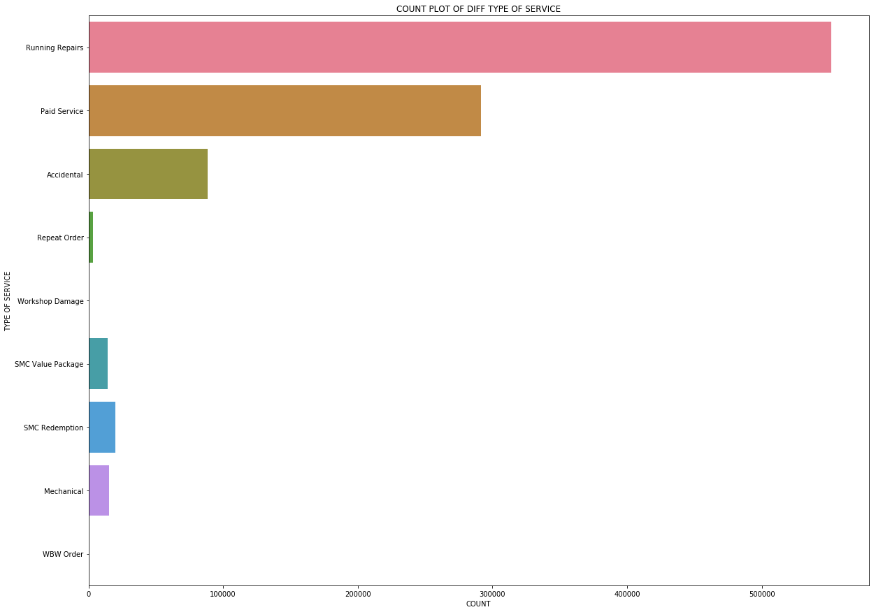
Data Insights
Most Famous Orders Types Across India
Running Repairs is the most
Common type of service rendered
At MFCS followed by Paid Service
And Accidental

Slide 9
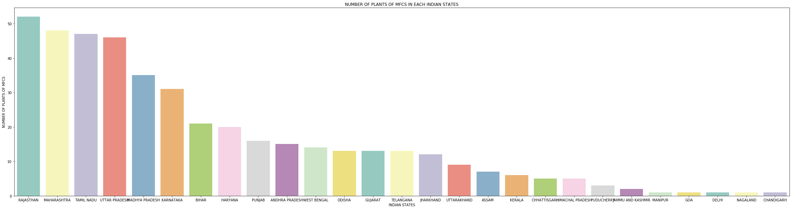
Data Insights
Count Of MFCS Plants Across India
Rajasthan has maximum number of plants followed by Maharashtra and Tamil Nadu

Slide 10
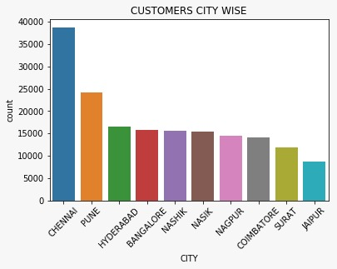
Data Insights
Top 10 Cities With Maximum Number of Customers
1.CHENNAI gets the max no of customers
2.PUNE
3.HYDERABAD

Slide 11
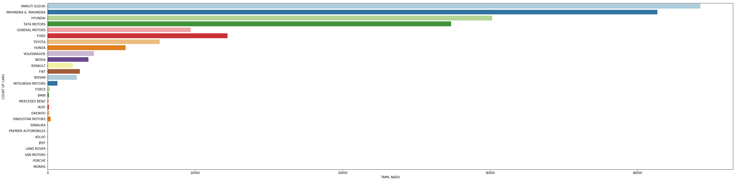
Data Insights
State Wise Distribution Of Car Make
Tamil Nadu

Slide 12
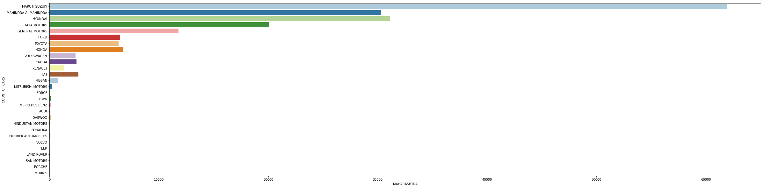
Data Insights
Maharashtra

Slide 13
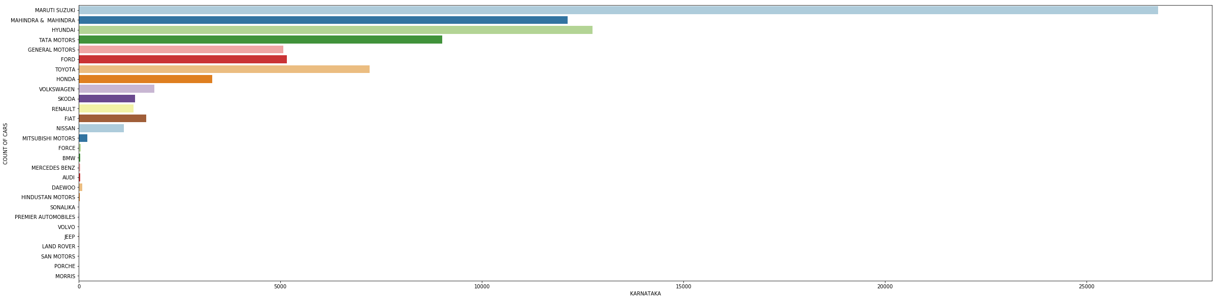
Data Insights
Karnataka

Slide 14
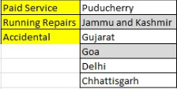
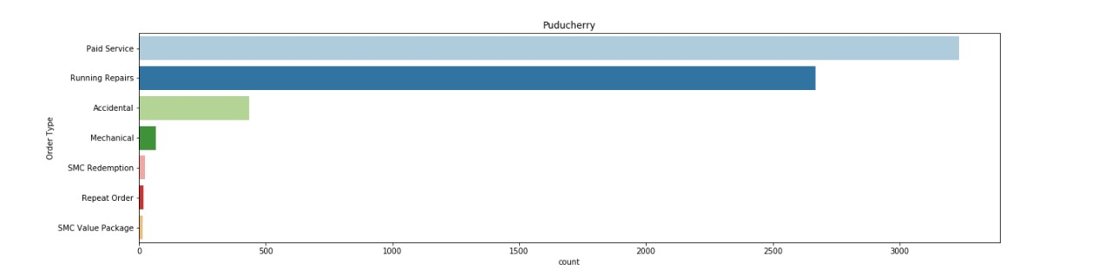
Data Insights
Top Service Order type in various states
Paid service
Running Repairs
Accidental

Slide 15
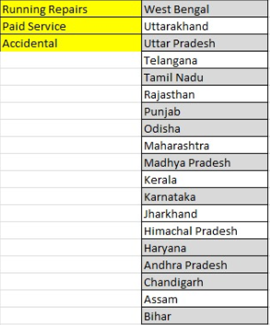
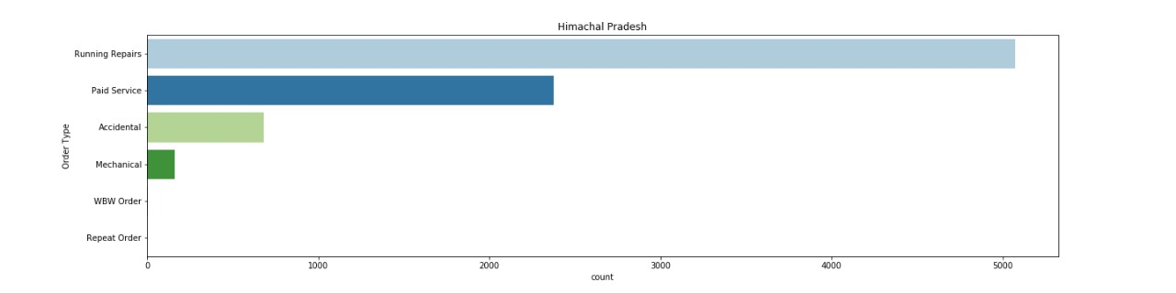
Data Insights
Running Repairs
Paid Service
Accidental

Slide 16
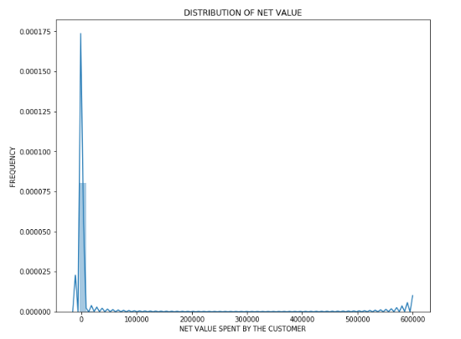
Data Insights
The distribution of the Net Value spent
by the customers is positively skewed
with its peak at 0 Rs

Slide 17
Feature Engineering
By taking the difference between the job date time and invoice date time we created a new feature service time category.
Service time category was categorised into super_fast,fast,mid,slow,super_slow
Super_fast: Less than 13 hr
Fast: 13-36 hr
Mid: 36-61 hr
Super_slow: 61-84 hr
Slow: More than 84 hr

Slide 18
Modeling the data for Clustering
Columns with unique values were dropped.
Jtd was grouped based on customer no.
First, Invoice and Customer was merged on customer no,then with Jtd.
For the purpose of clustering we have considered only the following columns: Cust Type,Order Type,Vehicle Model,City,ServiceTime_category Labour Total,Parts Total,Total Amt Wtd Tax.,Partner Type,Title,Fuel Type Order Quantity,Net value
Each row in the clustered data represents a single customer.

Slide 19
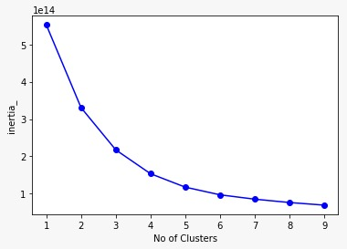
Clustering
K-Means clustering was used to cluster/segment the customers into groups
The number of clusters for customer segmentation were decided using Elbow Method.
At k=5 there is a significant drop in the WCSS (within cluster sum of squared error).

Slide 20
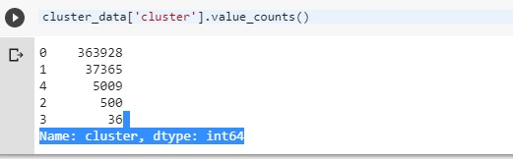
Clustering
After clustering we found 5 clusters with the number of customers grouped into the 5 clusters

Slide 21
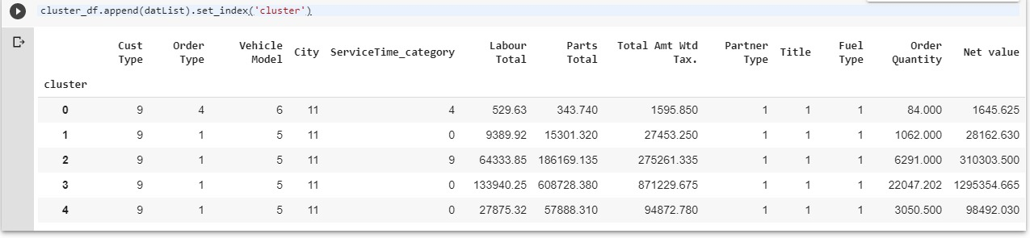
Cluster Identification
Each cluster can be identified with the unique properties given in the columns

Slide 22
Suggestions
Customer feedback to improve services
Efficient management of the resource available
Cross Selling of Cars
Identifying the reason why in some states Paid service is more popular than other service
Spare Parts used most often.

